Slide 1
Appendix 21A
Composite Forecasting Method
(21.3.3)
By
Cheng Few Lee
Joseph Finnerty
John Lee
Alice C Lee
Donald Wort

Slide 2
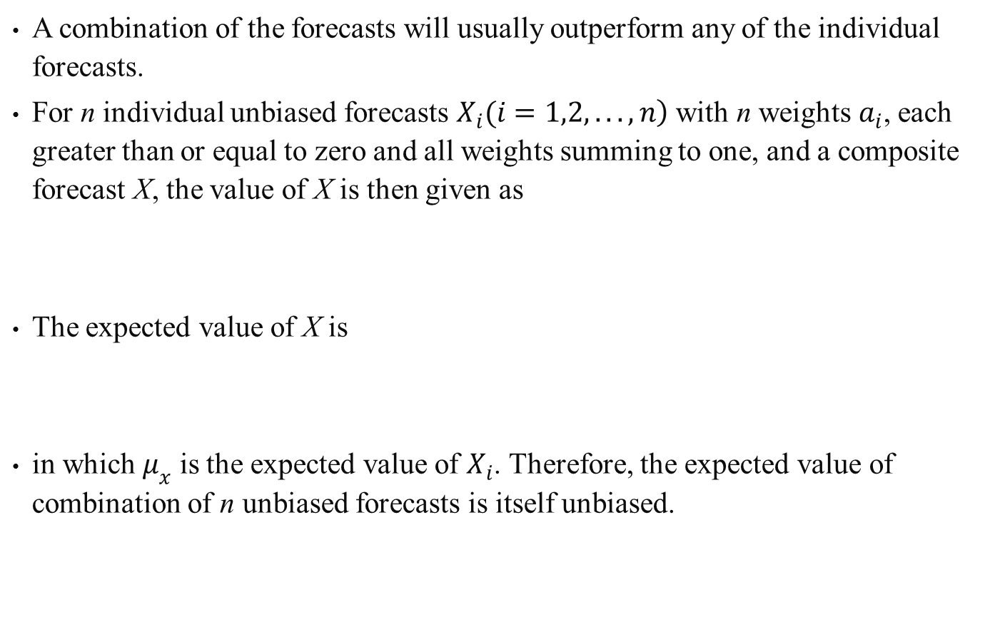
A combination of the forecasts will usually outperform any of the individual forecasts.
For n individual unbiased forecasts $\left.X_{i}(i=1,2,...,n\right)$ with n weights $a_{i}$, each greater than or equal to zero and all weights summing to one, and a composite forecast X, the value of X is then given as
The expected value of X is
in which $μ_{x}$ is the expected value of $X_{i}$. Therefore, the expected value of combination of n unbiased forecasts is itself unbiased.

Slide 3
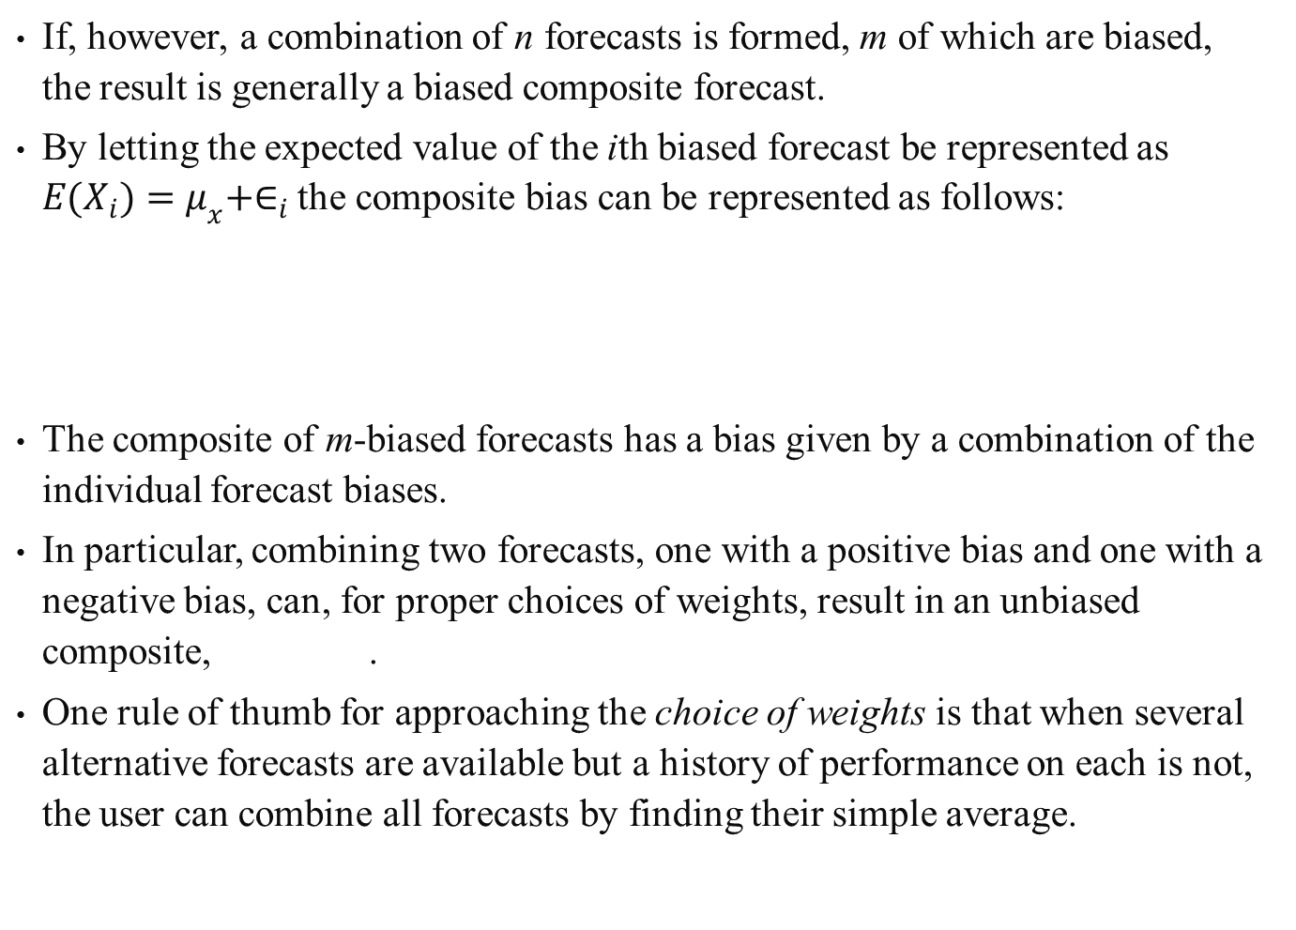
If, however, a combination of n forecasts is formed, m of which are biased, the result is generally a biased composite forecast.
By letting the expected value of the ith biased forecast be represented as $E(X_{i})=μ_{x}+∈_{i}$ the composite bias can be represented as follows:
The composite of m-biased forecasts has a bias given by a combination of the individual forecast biases.
In particular, combining two forecasts, one with a positive bias and one with a negative bias, can, for proper choices of weights, result in an unbiased composite, .
One rule of thumb for approaching the choice of weights is that when several alternative forecasts are available but a history of performance on each is not, the user can combine all forecasts by finding their simple average.

Slide 4
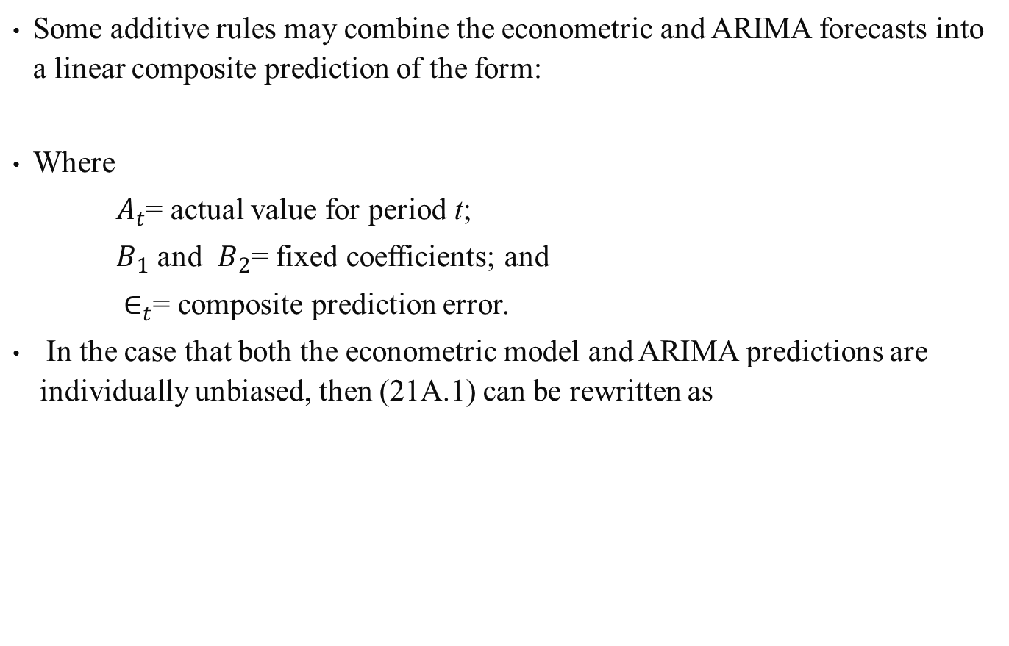
Some additive rules may combine the econometric and ARIMA forecasts into a linear composite prediction of the form:
Where
    $A_{t}$= actual value for period t;
    $B_{1}$ and $B_{2}$= fixed coefficients; and
    $∈_{t}$= composite prediction error.
In the case that both the econometric model and ARIMA predictions are individually unbiased, then (21A.1) can be rewritten as
(21A.1)
(21A.2)

Slide 5
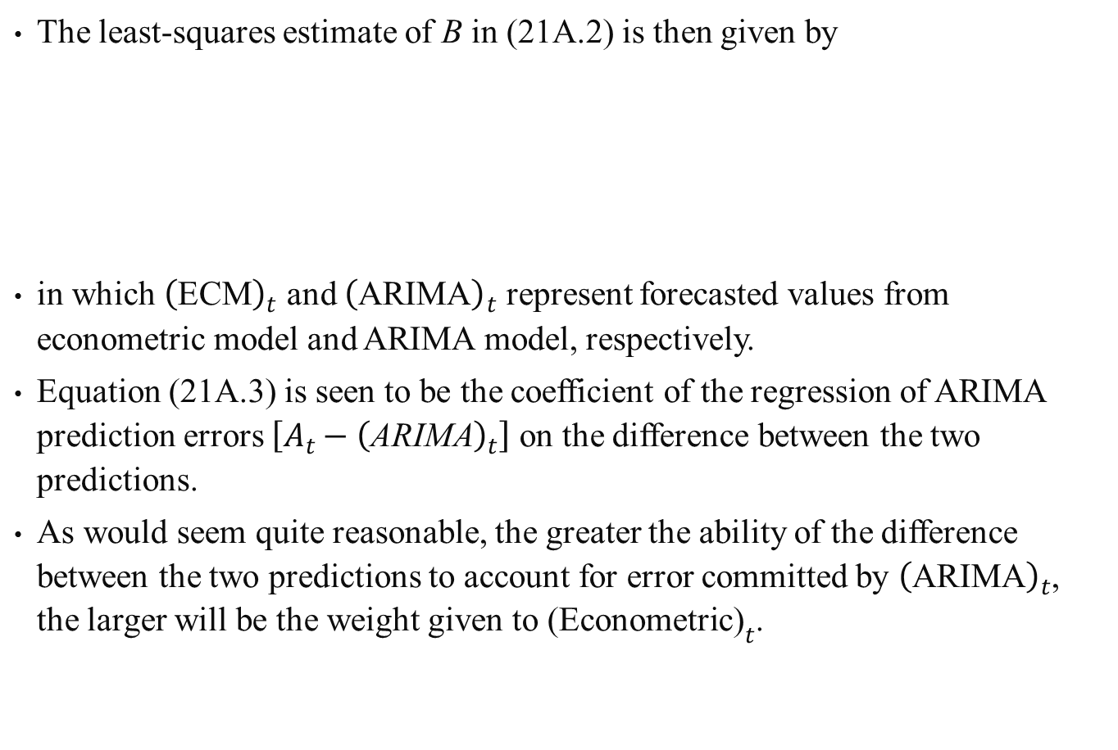
The least-squares estimate of B in (21A.2) is then given by
in which ${\left(\text{ECM}\right)}_{t}$ and ${\left(\text{ARIMA}\right)}_{t}$ represent forecasted values from econometric model and ARIMA model, respectively.
Equation (21A.3) is seen to be the coefficient of the regression of ARIMA prediction errors $\left[A_{t}−{\left(\text{ARIMA}\right)}_{t}\right]$ on the difference between the two predictions.
As would seem quite reasonable, the greater the ability of the difference between the two predictions to account for error committed by ${\left(\text{ARIMA}\right)}_{t}$, the larger will be the weight given to ${\text{(}\text{Econometric}\text{)}}_{t}$.
(21A.3)

Slide 6
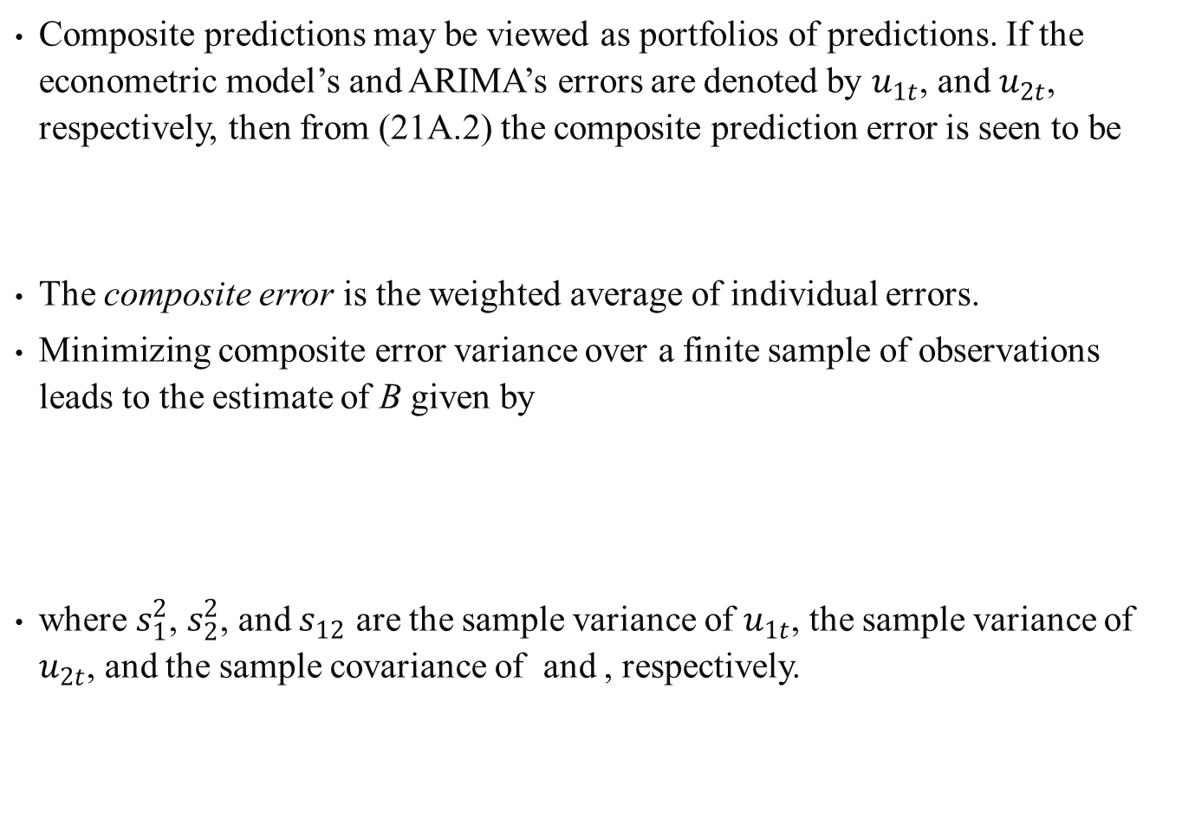
Composite predictions may be viewed as portfolios of predictions. If the econometric model’s and ARIMA’s errors are denoted by $u_{1t}$, and $u_{2t}$, respectively, then from (21A.2) the composite prediction error is seen to be
The composite error is the weighted average of individual errors.
Minimizing composite error variance over a finite sample of observations leads to the estimate of B given by
where $s_{1}^{2}$, $s_{2}^{2}$, and $s_{12}$ are the sample variance of $u_{1t}$, the sample variance of $u_{2t}$, and the sample covariance of and , respectively.
(21A.4)
(21A.5)

Slide 7
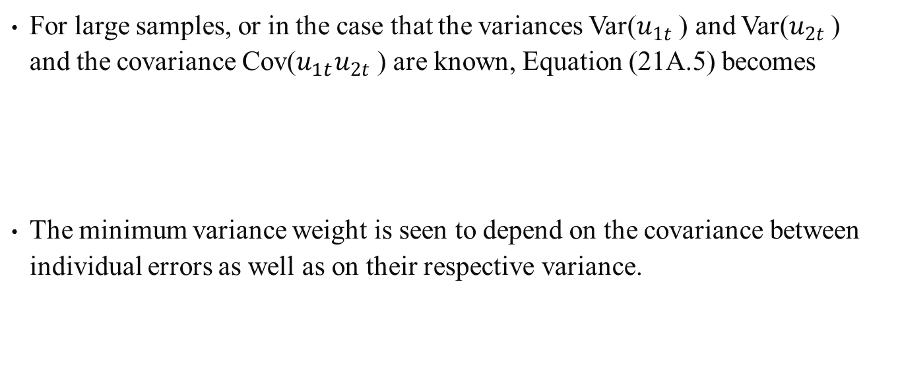
For large samples, or in the case that the variances Var($u_{1t}$ ) and Var($u_{2t}$ ) and the covariance Cov($u_{1t}u_{2t}$ ) are known, Equation (21A.5) becomes
The minimum variance weight is seen to depend on the covariance between individual errors as well as on their respective variance.
(21A.6)

